Slide 1
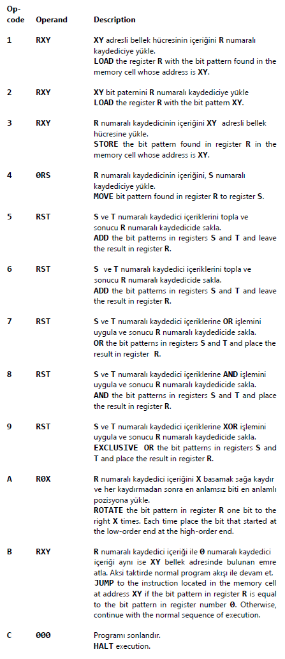
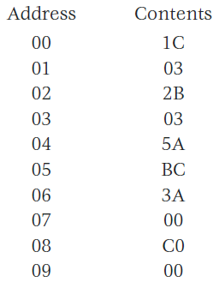
Suppose the memory cells at addresses 00 through 09 in the machine described in Appendix C contain the following bit patterns. Assume that the machine starts with its program counter containing 00.
a. What will be in the memory cell at address 00 when the machine halts? 06
b. What bit pattern will be in the program counter when the machine halts? 0A

Slide 2
In each of the following cases, write a short program in the machine language described in Appendix C to perform the requested activities. Assume that each of your programs is placed in memory starting at address 00.
a. Move the value at memory location D8 to memory location B3.
b. Interchange the values stored at memory locations D8 and B3.
c. If the value stored in memory location 44 is 00, then place the value 01 in memory location 46; otherwise, put the value FF in memory location 46.
a. b. c.
14D8 14D8 2000
34B3 15B3 1144
C000 35D8 B10A
34B3 22FF
C000 B00C
2201
3246
C000

Slide 3
Suppose the following program, written in the machine language of Appendix C, is stored in main memory beginning at address 30 (hexadecimal). What task will the program perform when executed?
It copies the data from the memory cells at addresses 00, 01, and 02 into the memory cells at addresses 10, 11, and 12
30-> 2003
32-> 2101
34-> 2200
36-> 2310
38-> 1400
3A-> 3410
3C-> 5221
3E-> 5331
40-> 3239
42-> 333B
44-> B248
46-> B038
48-> C000

Slide 4
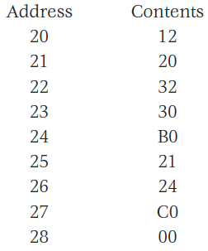
Suppose the memory cells at addresses 20 through 28 in the machine described in Appendix C contain the following bit patterns. Assume that the machine starts with its program counter containing 20.
a. What bit patterns will be in registers 0, 1, and 2 when the machine halts?
b. What bit pattern will be in the memory cell at address 30 when the machine halts?
c. What bit pattern will be in the memory cell at address B0 when the machine halts?
The point to this problem is that a bit pattern stored in memory is subject to interpretation it may represent part of the operand of one instruction and the op-code field of another.
a. Registers 0, 1, and 2 will contain 32, 24, and 12, respectively.
b. 12
c. 32

